Slide 1
Contents
1. Input and Output (I/O) Devices in Operation
2. Storage Devices – Magnetic and Optical
3. The I / O Bus
4. Input Devices
5. Output Devices
6. Input and Output Devices

Slide 2

1. Input and Output in Operation
1.1 Input/Output and Storage in Office Systems
Office Computer System
A typical office has equipment that is familiar to most people who have access to PC technology:
The input devices are the keyboard and the mouse, and sometimes a scanner which may be either flat bed or hand held.
The output devices are a monitor or display terminal, based on either a CRT (Cathode Ray Tube) or a LCD (Liquid Crystal Display); a printer; possible speakers used.

Slide 3
Input/Output and Storage in Office Systems
The storage devices include the hard disk, tape streamers, floppy disks, CD (Compact Disc) and DVD (Digital Versatile Disc) ROMs.

Slide 4
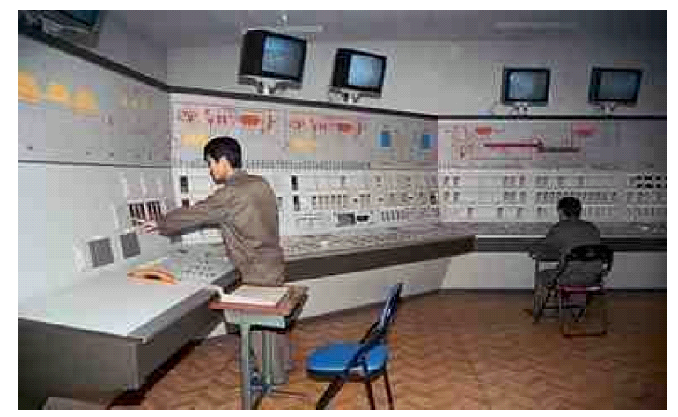
1.2 Input and Output in an Industrial Control System
Industrial Control System
A computer System in an industrial control facility, such as one controlling the distribution of a utility such as water, gas or electricity would have a different set of input and output devices from those listed above. they would be likely to present in a secure back office facility for maintenance and management purposes only.

Slide 5
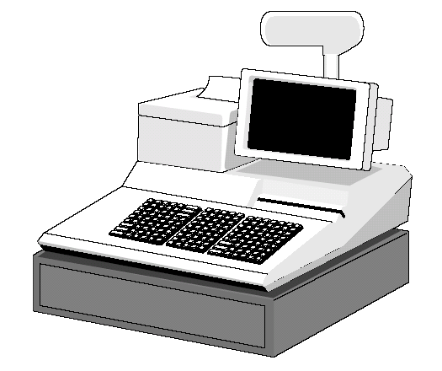
1.3 Input Output and Storage in a Retail environment
The Point of Sale (POS) terminal as seen in many retail environments, different computer I/O in operation Devices include:
Barcode reader, and item selection panel.
Specialized equipment linked to the system such as till drawer and customer display.
A magnetic card swipe and modem or digital network connection for Electronic Funds Transfer (EFT).
A receipt printer.
Point of Sale Terminal

Slide 6
Memory Organization
Memory Technology
Memory Device Characteristics

Slide 7
Memory Organization
Memory Types:
CPU registers
Main (primary) memory
Secondary memory
Cache

Slide 8
Memory Organization
Secondary
Memory
CPU
Cache
Level 2
Main
Memory
Cache
Level 1
Register
File
Figure 6.1: Conceptual organization of a multilevel memory system in a computer

Slide 9
2. Storage Devices
2.1 Primary and Secondary Storage
Storage devices are an essential component in any computer system. They enable the user to recall information that has already been entered. All computers have primary memory – otherwise known as main memory, typically referred to as Random Access Memory (RAM); on a temporary basis, as long as nothing interrupts the operation of the computer, this could be classed as a storage medium. However, when the power to the computer is lost the contents of this memory are lost. Memory that has this characteristic is often called volatile.
Secondary Storage Devices
Magnetic disks
      hard disk
      floppy disk
      high capacity portable disks
Optical discs
      CD ROM, CD R and DVD
Magnetic tape

Slide 10
Primary storage device
Alternatively referred to as internal memory, main memory, and primary storage is a storage location that holds memory for short periods of times while the computer running. For example, computer RAM and cache.
Secondary storage device
Alternatively referred to as external memory and auxiliary storage, secondary storage is a storage that holds information until it is deleted or overwritten regardless if the computer has power. For example, a floppy disk drive and hard drive

Slide 11
Secondary Storage
Secondary storage devices are used as a more permanent (non-volatile) form of data storage. These include:
    Magnetic disks and optical discs
    Magnetic Tape

Slide 12
Hard drive
Alternatively referred to as a hard disk drive and abbreviated as HD or HDD, the hard drive is the computer's main storage media device that permanently stores all data on the computer. The hard drive was first introduced on September 13, 1956.

Slide 13
Hard Disk:
Usually used as secondary storage,
Also called fixed disk,
Consists of one or more metal plates cylinder,
Metal plates are coated with magnetic material to store data,
Also have an access arm and read / write heads.

Slide 14
2.2.1 Hard Disk Physical and Logical Part
Hard disk should have two parts:
      Physical Part
        Platter
        Read/Write header
      Logical Part
        Track
        Sector
        Pie Shape
        Cylinder

Slide 15
Disk Format
Each surface has a number of concentric tracks, with each track being divided into a number of sectors. A sector (ranging from 256 bytes to 16 Kbytes) is the smallest unit that can be read or written in a single operation.
The data transfer rate may range from 62 Kbytes per second on a floppy disk drive to 200 Mbytes per second or greater on a hard / fixed disk.
Current hard disks rotate at about 7200 – 10,000 revolutions per minutes.

Slide 16
Looking at a surface
tracks
sector
Surface of disk showing tracks and sectors
CENG 351

Slide 17
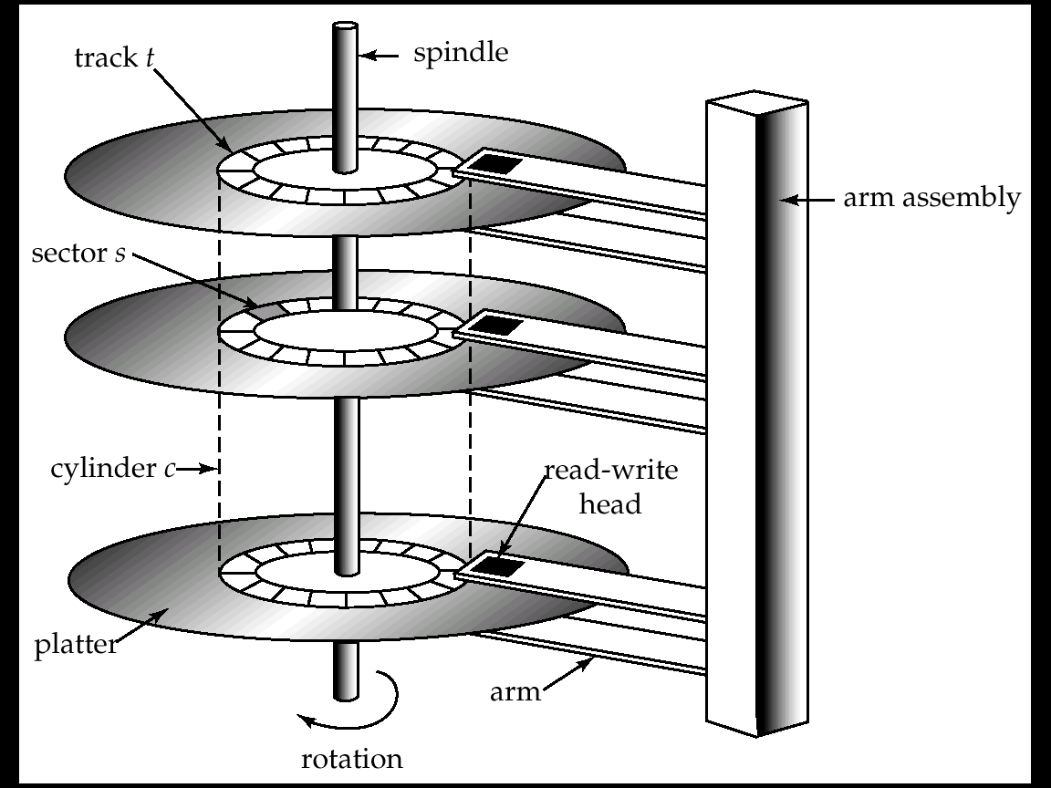
Hard Disk Mechanism

Slide 18
Read-write head
  Positioned very close to the platter surface (almost touching it)
Surface of platter divided into circular tracks
Each track is divided into sectors.
  A sector is the smallest unit of data that can be read or written.
To read/write a sector
  disk arm swings to position head on right track
  platter spins continually; data is read/written as sector passes under head
Block: a sequence of sectors
Cylinder i consists of i^{th} track of all the platters

Slide 19
Floppy Disk:
A small plastic plate coated with magnetic material,
Stored data in magnetic spots,
Used to transfer data from one computer to another.

Slide 20
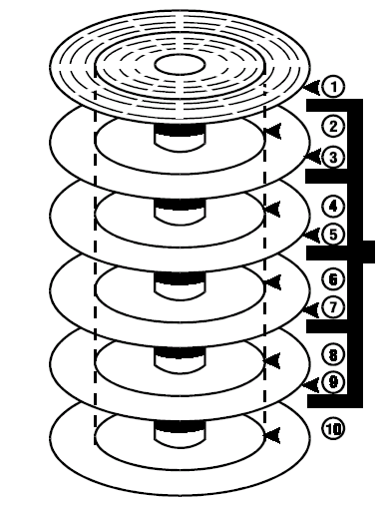
Magnetic Disks Access Mechanisms
Head assembly in
any one Position can access a cylinder of 10 tracks (one on
each disk Surface)

Slide 21
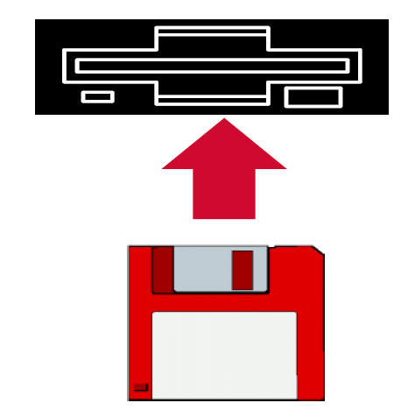
2.3 Floppy-Disk Drives
Floppy disks are one of the simplest form of magnetic disk. They are made of flexible plastic which is covered with a magnetisable coating.
The size of floppy is 3.5 inch
Capacity 1.44 Mbytes
Rotational speed 300 revolution per minute (rpm)

Slide 22
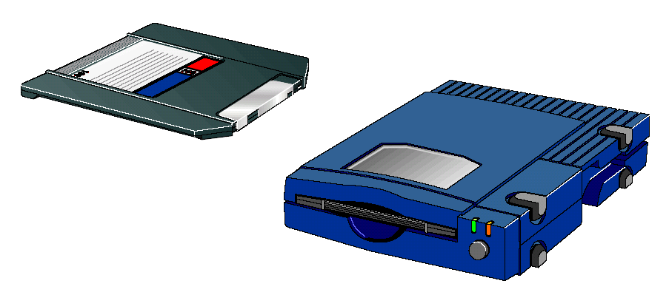
2.4 Superdisks and Zip Disks
100 Mbyte Zip Disk and Drive
A new breed of magnetic portable disks have recently become popular for transfer of large quantities of information. These are known as Superdisk or Zip disks, and are a similar physical size to a 3.5 inch floppy, but have a significantly large capacity.
These disks hold between 100 and 270 Mbytes of data with a sustained transfer rate of 0.8 Mbytes per second.

Slide 23
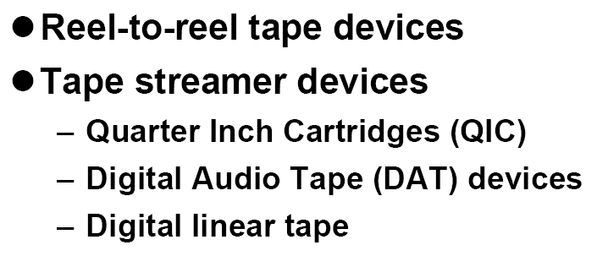
2.5 Magnetic Tape Drives and Storage
Magnetic Tape Storage

Slide 24
Magnetic Tape Drives and Storage
Magnetic tape is now principally used only as a backup medium. It is also used to archive records of past transactions for long-term storage, as it is cheap, robust and easily used to store large quantities of data. Today there are several basic types of magnetic tape device in general use:
    reel-to-reel tape devices;
    tape streamer devices:
      Quarter Inch Cartridges (QIC)
      Digital Audio Tape (DAT) devices;
      digital linear tape.

Slide 25
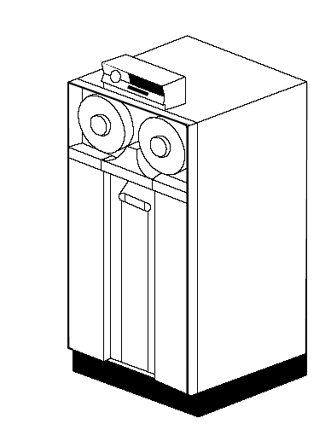
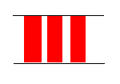
2.5.1 Reel-to-Reel Tape Drive
Code or Byte or Character
Inter-block gap
Magnetic Tape

Slide 26
Reel-to-Reel Tape Drive
Reel –to-reel computer tape is plastic tape covered with a magnetisable coating. Data is stored on it one character code at a time, each code using the full width of the tape. Data is stored on the tape in blocks which are separated by inter-block gaps. The data is read into the computer a block at a time and the tape drive pauses at the inter-block gap in readiness for reading the next block of data.
A standard tape may store anything between 800 and 6,250 characters/bytes per inch. A full length tape can be to 3,600 feet in length. The rate of transfer of characters from the magnetic tape into the CPU storage and vice versa during the read and write operations is typically in the range of 20,000 to 1,200,000 characters per second.

Slide 27
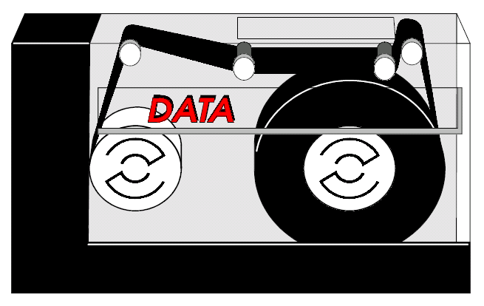
2.5.2 Tape Streamers
Cartridge Tape

Slide 28
Tape Streamers
Streamer tape is usually housed in a cartridge mechanism and is normally either ¼ or ½ inch wide. Although the data on a streamer tape exists in a similar format to that of reel-to-reel tape, it does not allow for stopping between data blocks and passes over the inter-gaps-blocks without passing. Long data block of up to 16,000 characters (16 Kbytes) are used to maintain a high rate of data transfer.
Streamer tape cartridges come in various sizes. They generally range from the size of a video cassette downwards. Tape cartridge units are becoming increasing popular because they can store more data and take up less space than conventional tape.
A typical tape streamer cartridge might contain 525 Mbytes of data, record at a density of 2,000 bytes per inch and transfer data at a rate of 2Mbytes per second.
A 525 Mbytes tape streamer for a PC network may cost between half and three quarters of the price of an entry-level IBM PC or compatible computer.

Slide 29
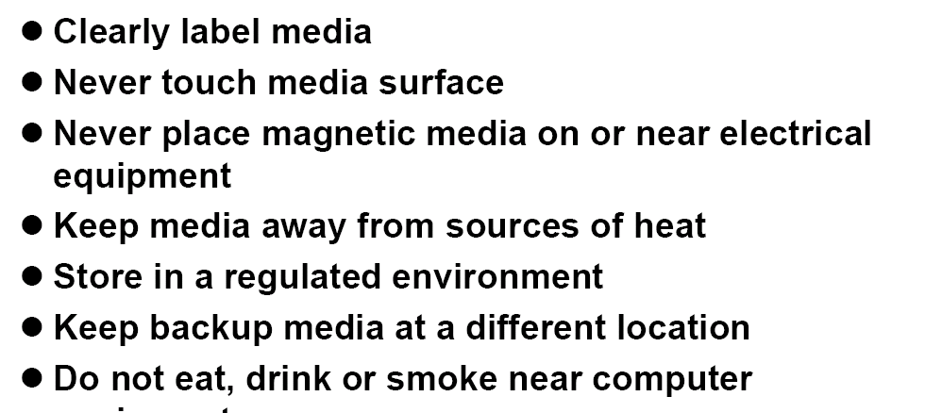
Media Care

Slide 30
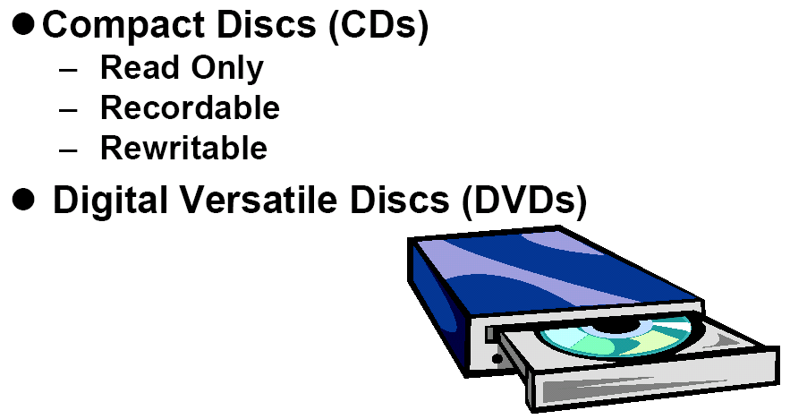
2.6 Optical Discs – CD and DVD

Slide 31
Optical Discs CD and DVDs
The CD (Compact Disc) and DVD (Digital Versatile Disc) are examples of how optical disc technology is becoming widespread in both consumer electronics and computing . Both use storage techniques base on light instead of relying on the principles of magnetism as in the case of other disks. The compact disc (CD) is generally used to record high quality music, whilst due to its increased capacity, the DVD is generally used to record high quality video.
The storage density of optical discs is enormous, the storage cost is very low, and access times on more recent highly specified devices are approaching those of hard disk drives. Just one CD-ROM disc stores about 650 Mbytes of data, which is sufficient to store all the volumes of a large encyclopaedia.

Slide 32
Optical Discs CD and DVDs
Optical memories: Optical or light based techniques for data storage have been the subject of intensive research for many years. Such memories usually employ optical disks, which resemble magnetic disks in that they store binary information in concentric tracks (or spiral track in the CD-ROM case) on an electromechanically rotated disk. The information is read or written optically, however with a laser replacing the read-write arm of a magnetic-disk drive. Optical memories offer extremely high storage capacities, but their access rates are generally less than those of magnetic disks. Read only optical memories are well developed, but low-cost read –write memories have proven difficult to build.

Slide 33
Optical Discs CD and DVDs
The CD-ROM is a well established read only optical memory. CD-ROM are an offshoot of the audio compact disks (CDs) introduced in the 1980s. They are manufactured in the same 12 cm format and can be mass produced at very low cost per disk by injection molding. Binary data is stored in the form of 0.1 µm width pits and lands (nonpitted areas)

Slide 34
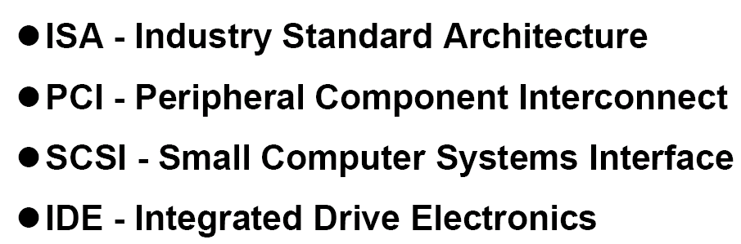
3. The I/O Bus

Slide 35
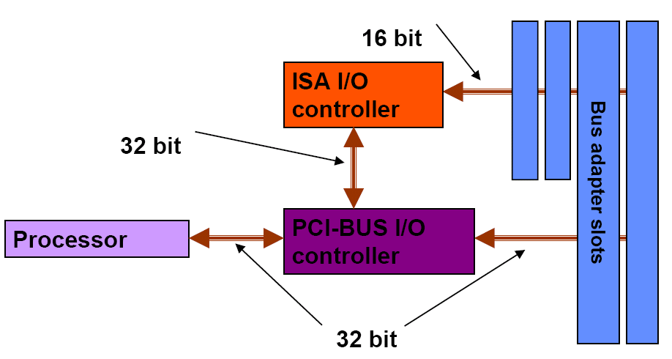
PCI Bus

Slide 36
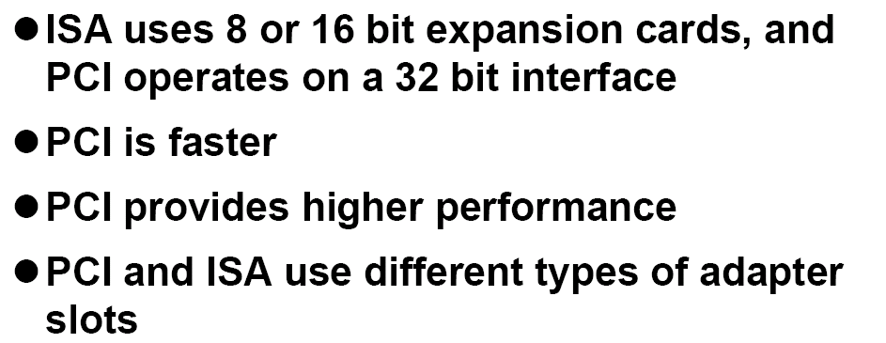
Difference between ISA and PCI Bus

Slide 37
4. Input Devices
Keyboard
Mouse
Scanners
Barcode Readers
Digital Camera
Sensors

Slide 38
5. Output Devices
Display Terminals
      SVGA display
      Cathode Ray Tube
      Liquid Crystal Displays
Printer
      Impact printer
        Dot Matrix
        Daisy Wheel
      Non Impact printer
        Ink Jet Printer
        Laser Printers

Slide 39
6. Input and Output Devices
Serial Ports
Parallel Ports
Universal Serial Bus (USB)
MODEM

